Slide 1

Take your kids on a vacation they won’t forget.

Slide 2
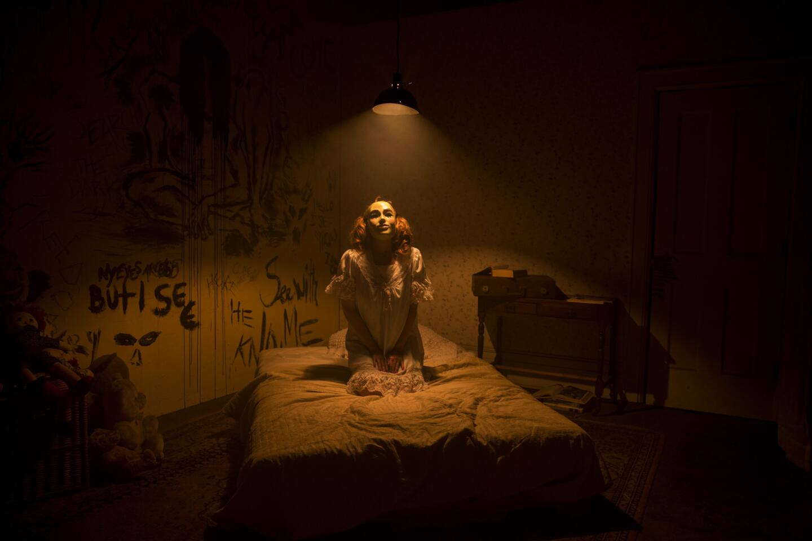
Let’s get spooky.
Admit it: you’re bored and complacent; the thrill has gone from your marriage, leaving nothing more than existential panic and a ticking clock (“are the kids 18 yet?”). Your children are bored with your generally apathetic demeanor.
That’s where we come in.
SleepInAHauntedHouse.com

Slide 3
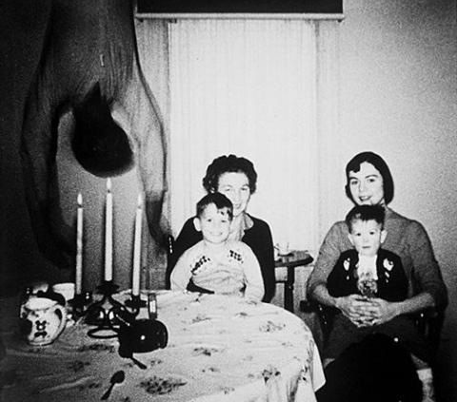
Our purpose is to provide families and lost souls alike the experience of a lifetime.

Slide 4
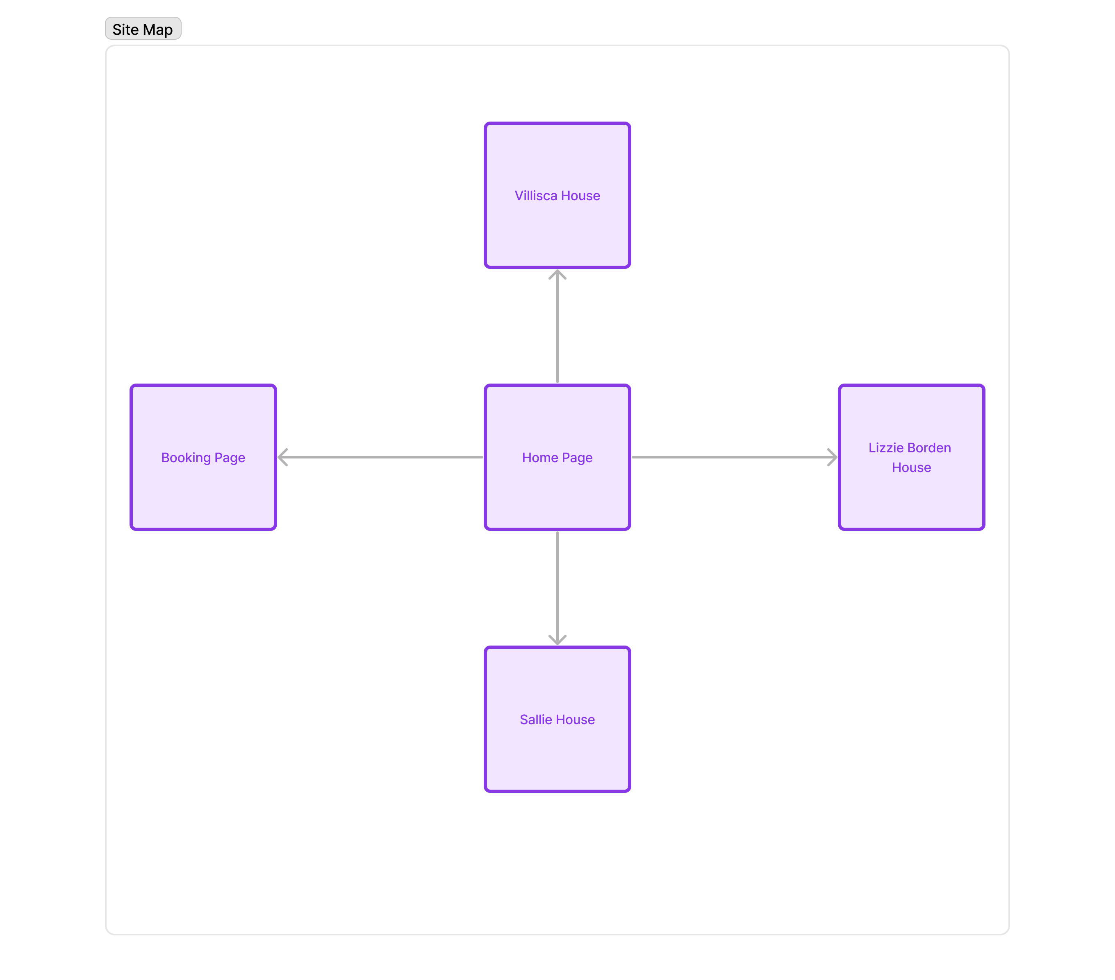
Site Map
Easy-to-navigate and delightfully basic.

Slide 5
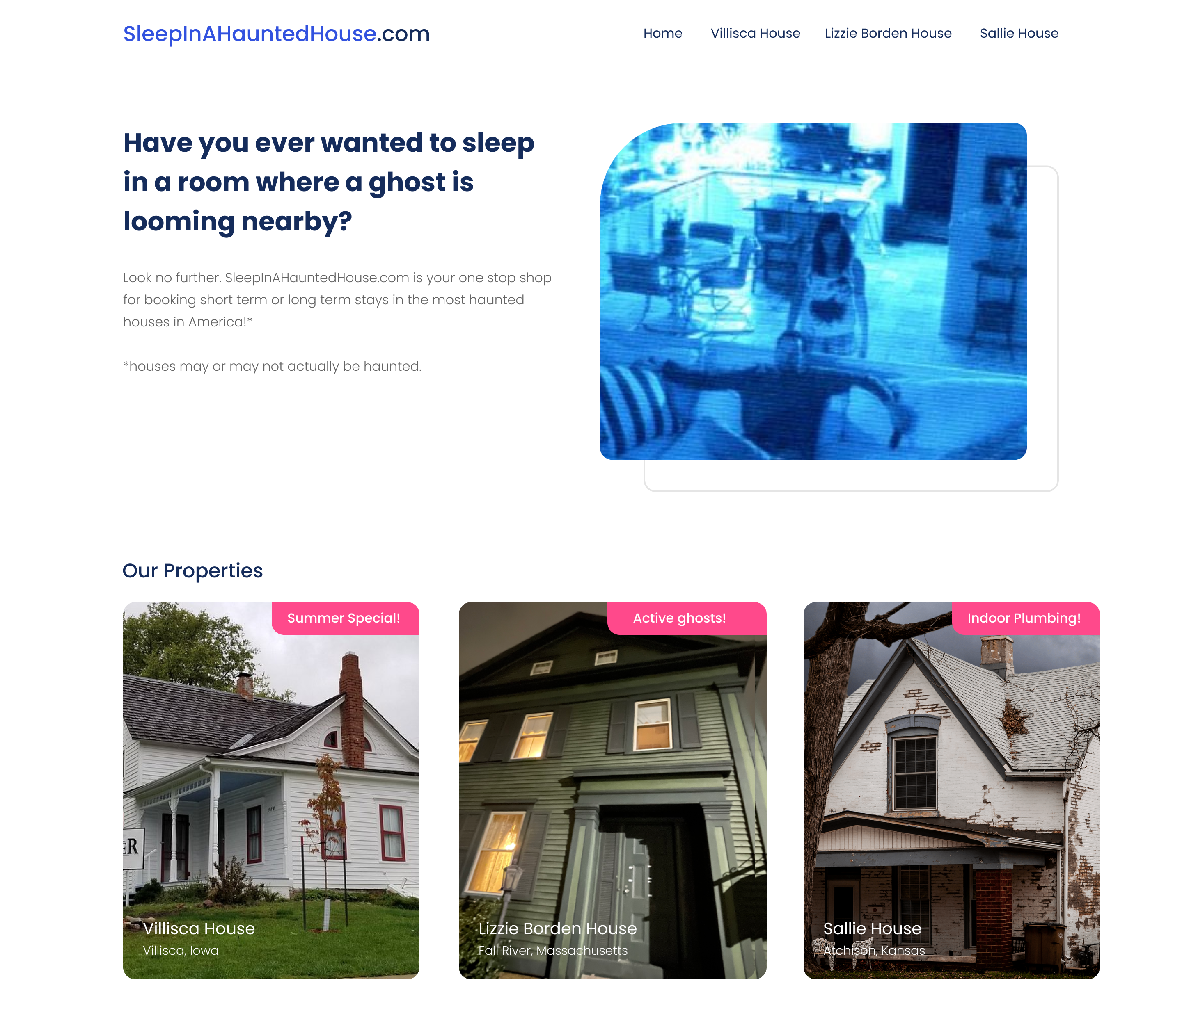
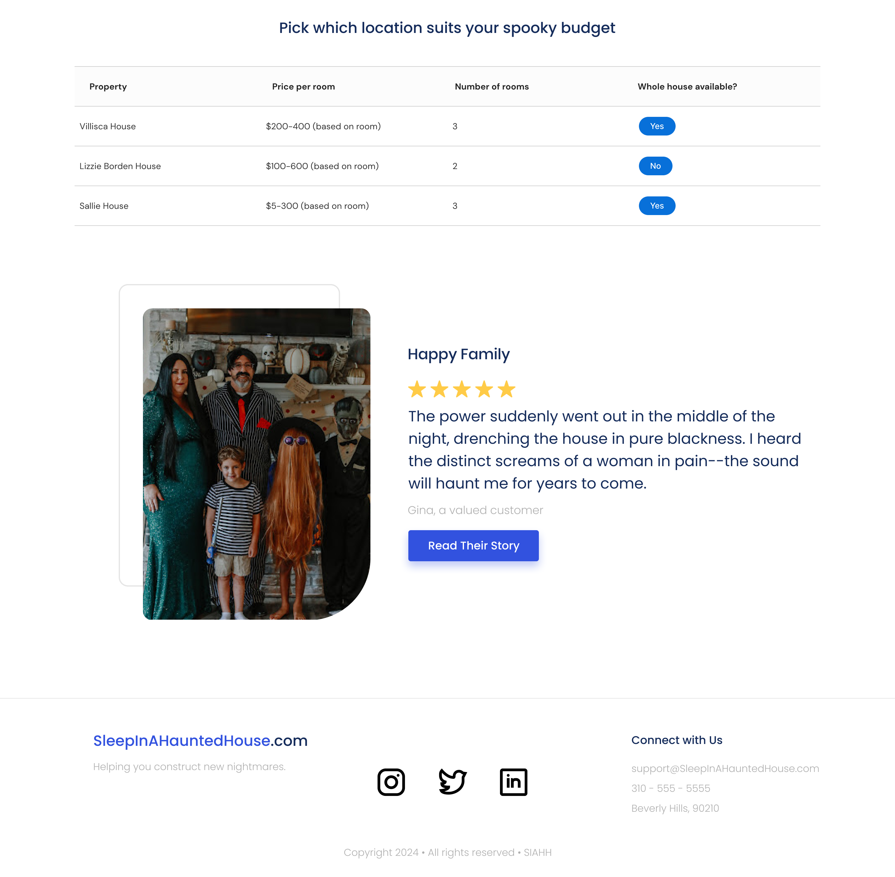
Home Page

Slide 6
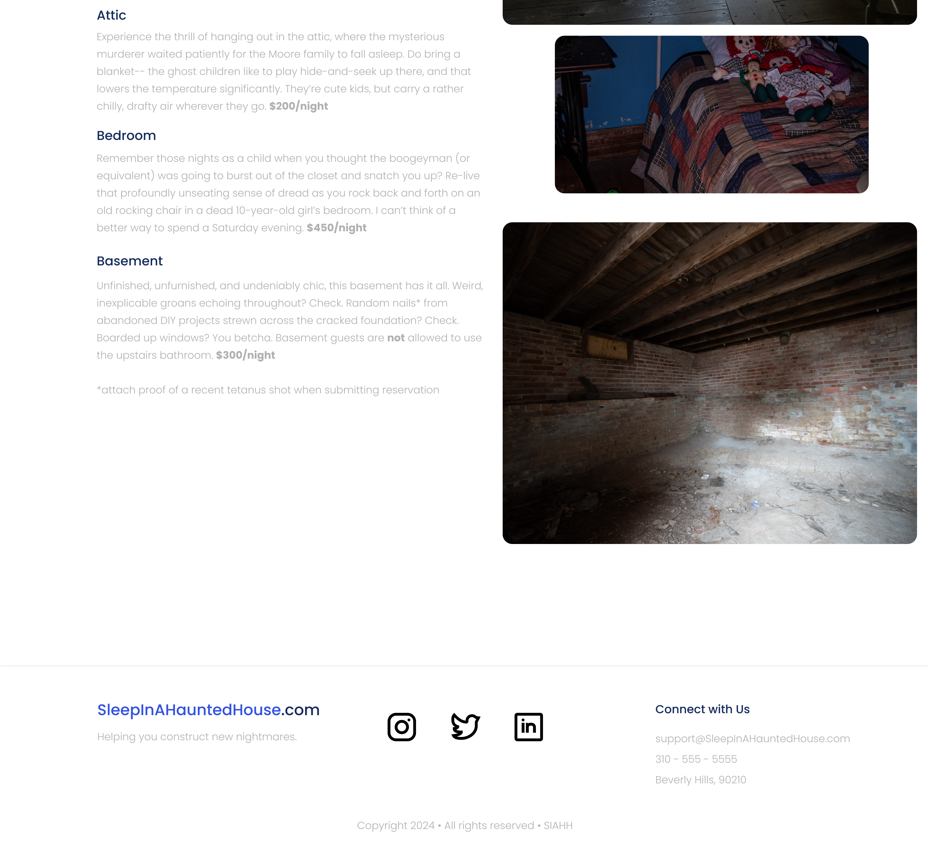
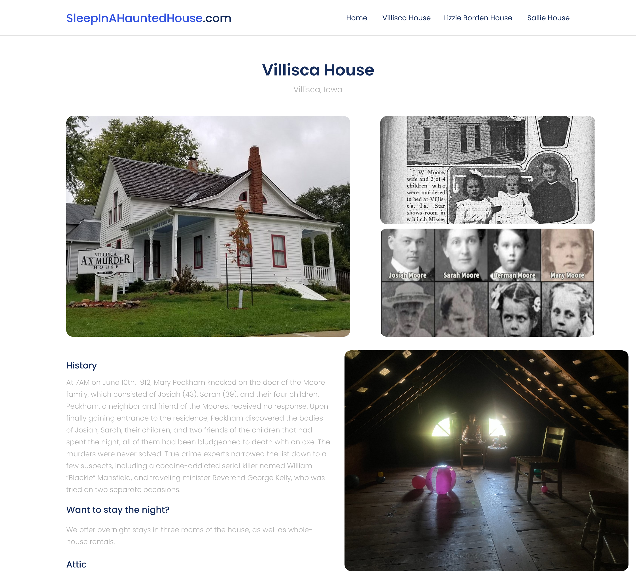
Villisca House

Slide 7
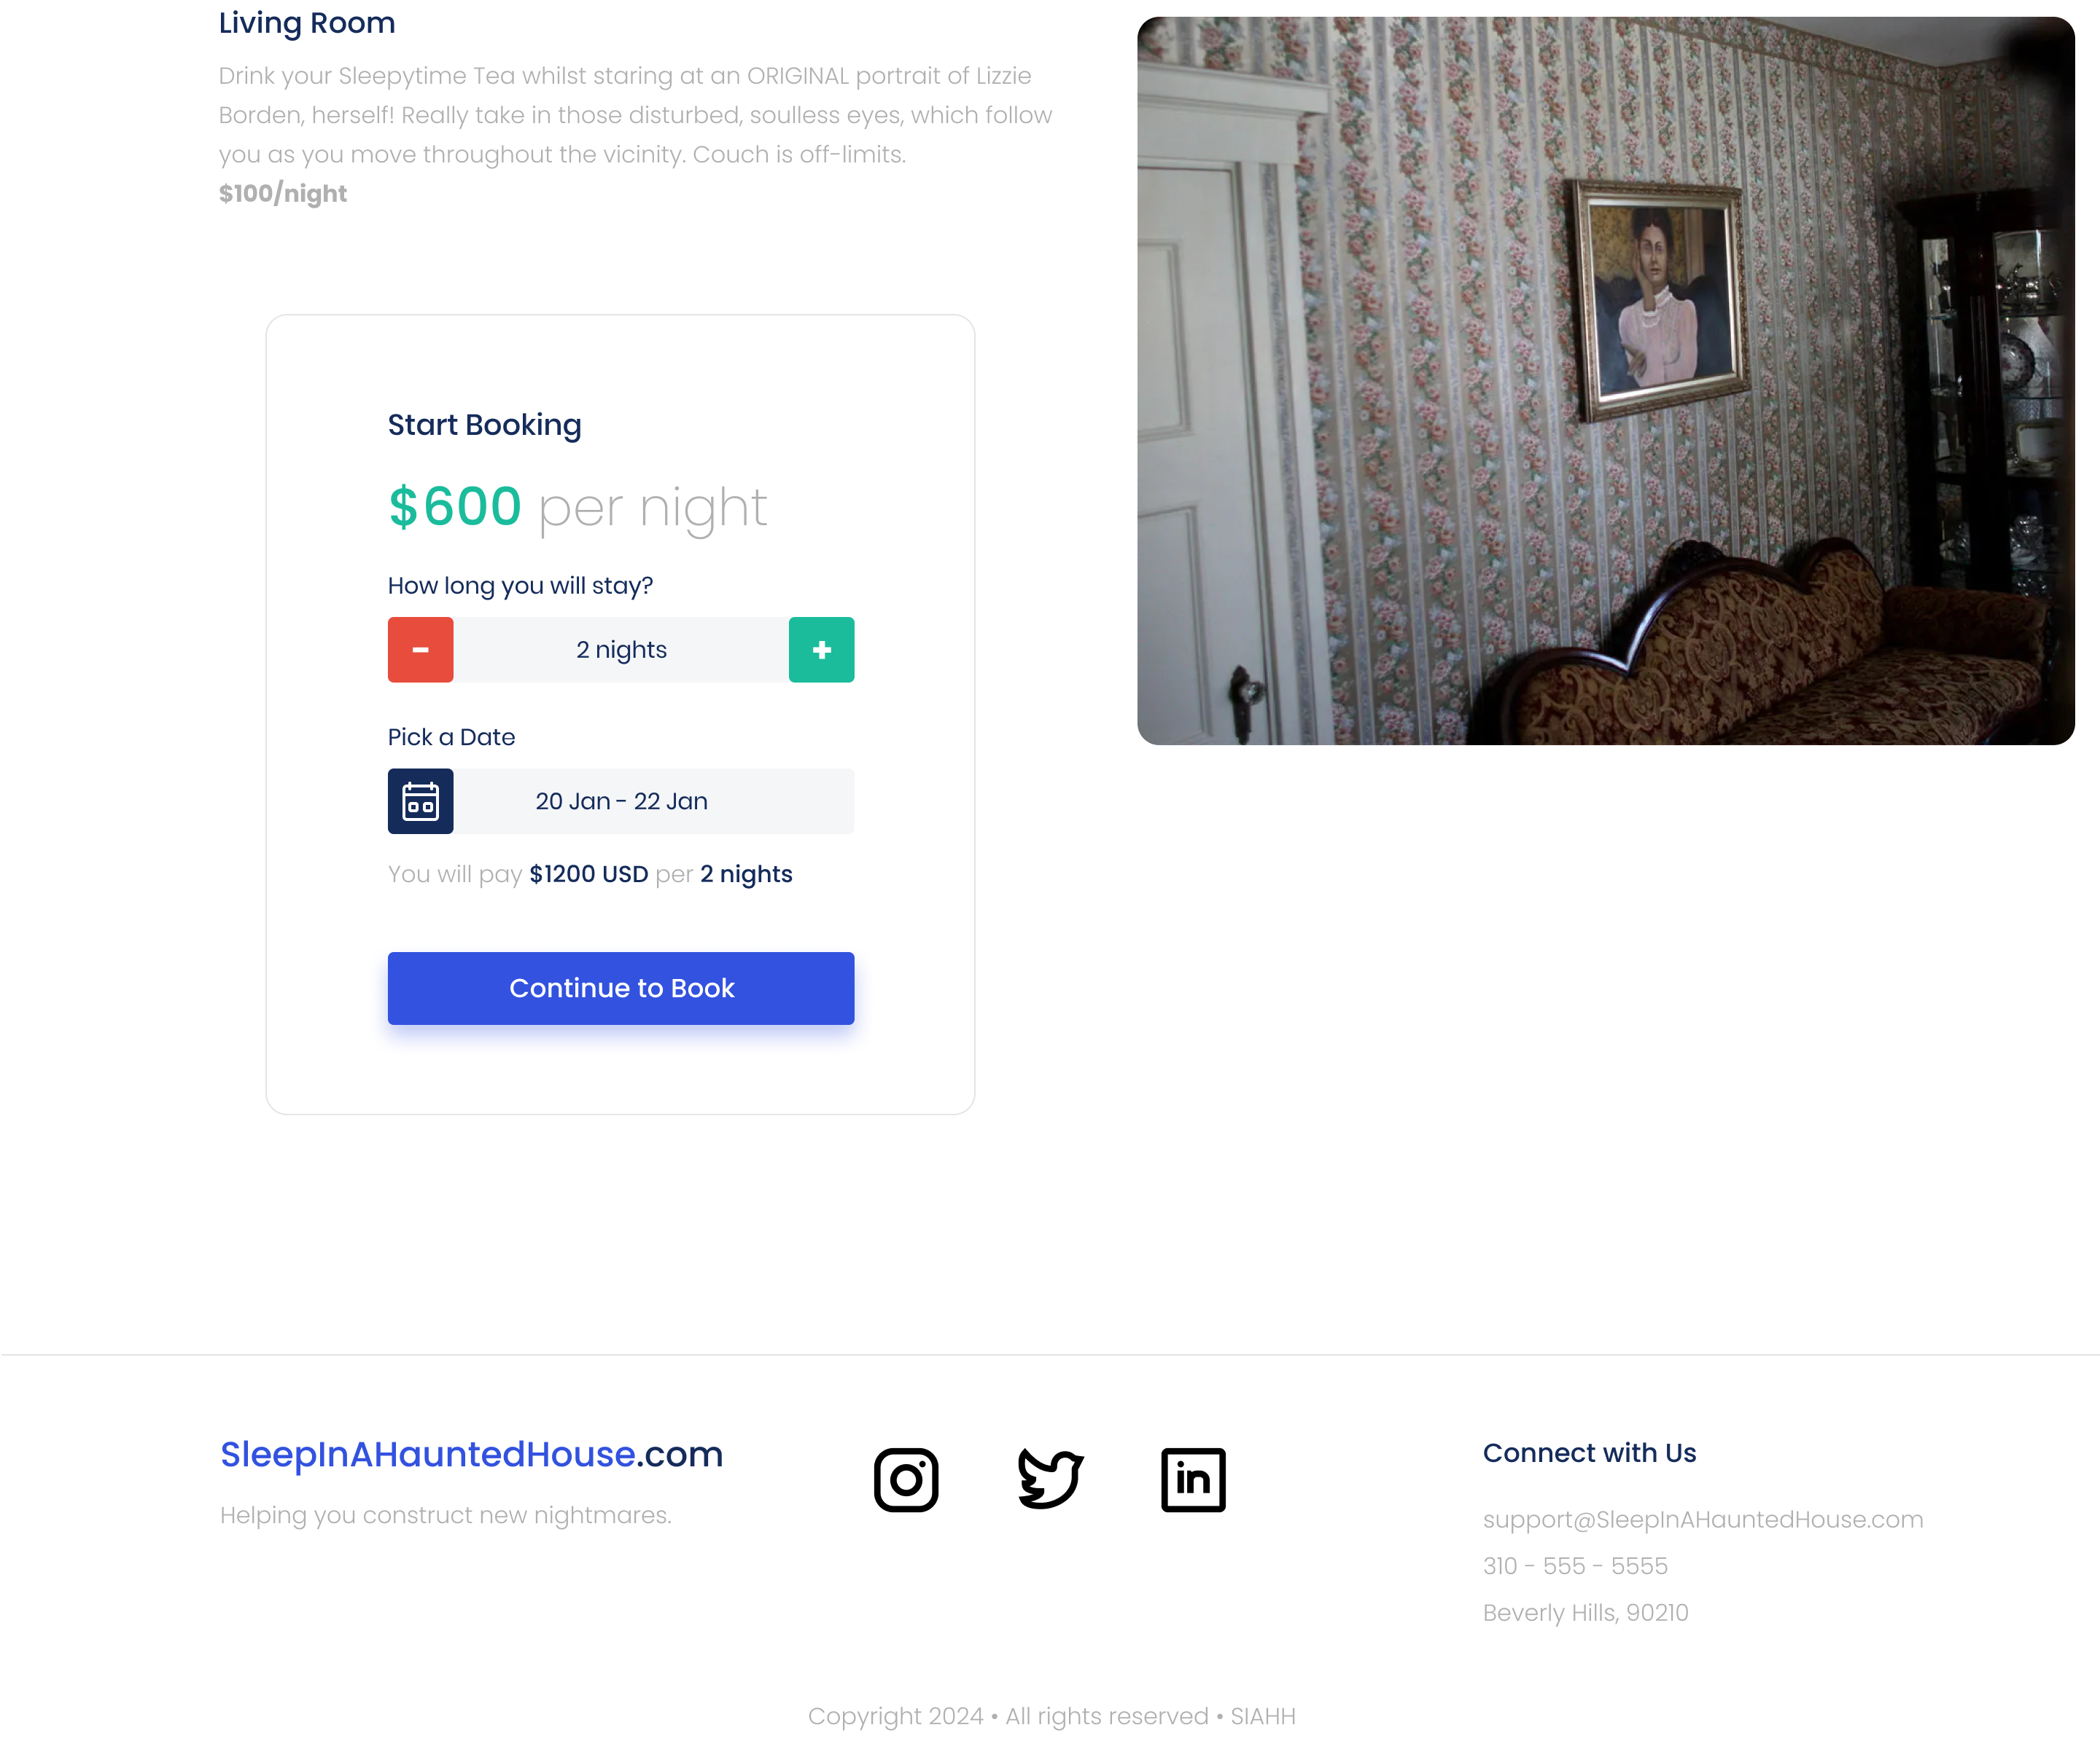
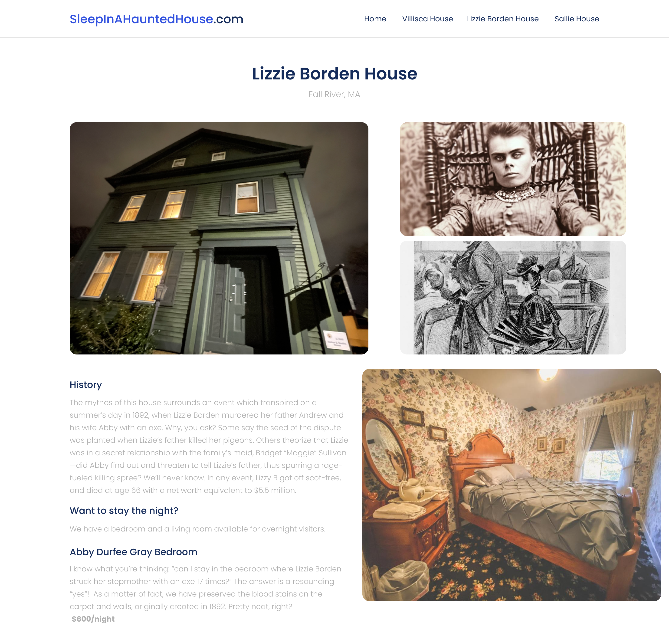
Lizzie Borden House

Slide 8
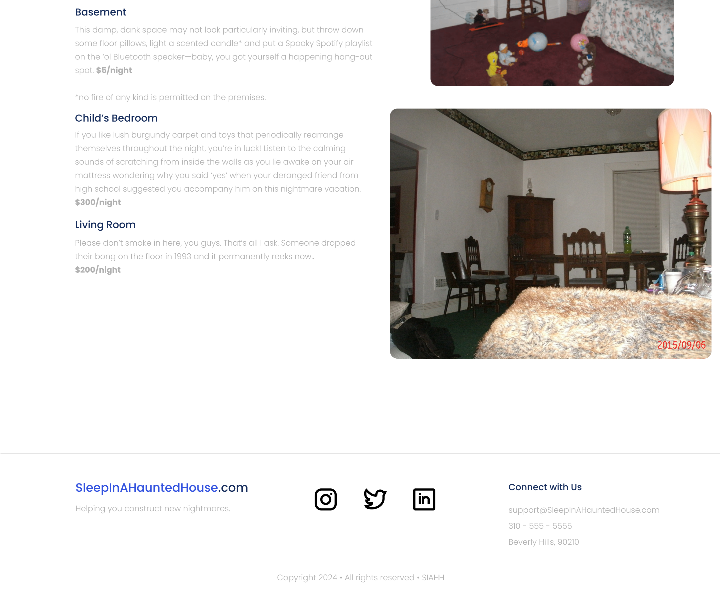
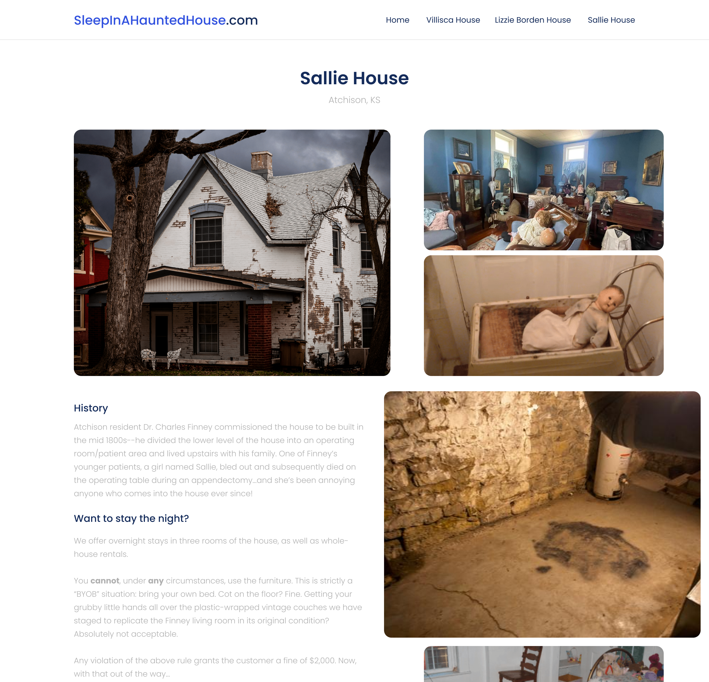
The Sallie House

Slide 9
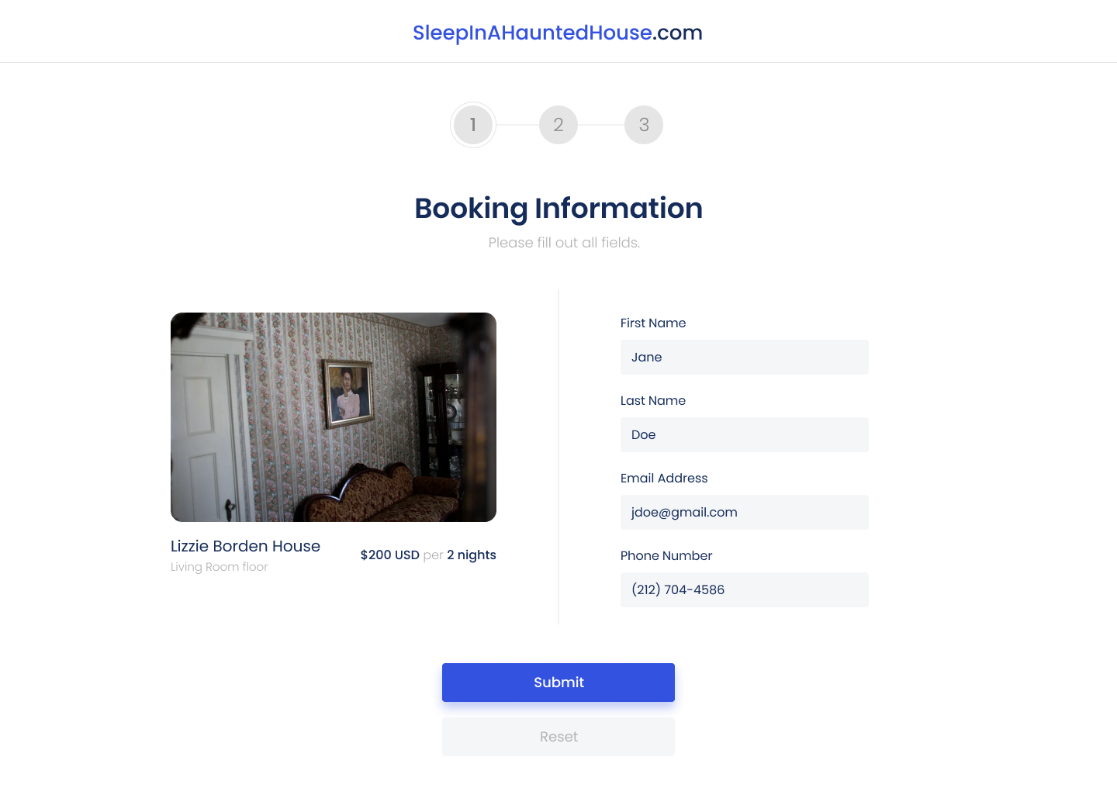
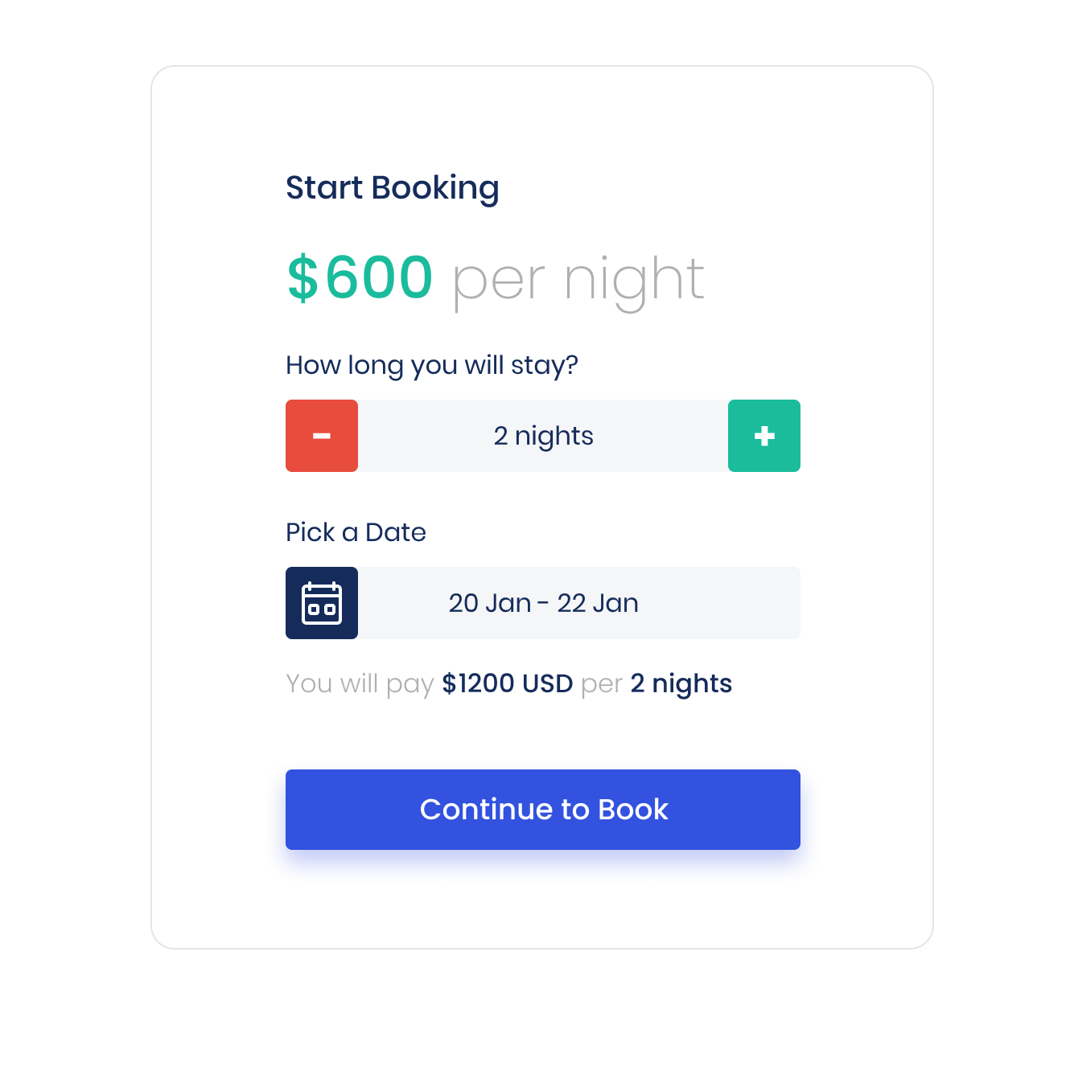
Booking Page
Smaller version available on detail page

Slide 10
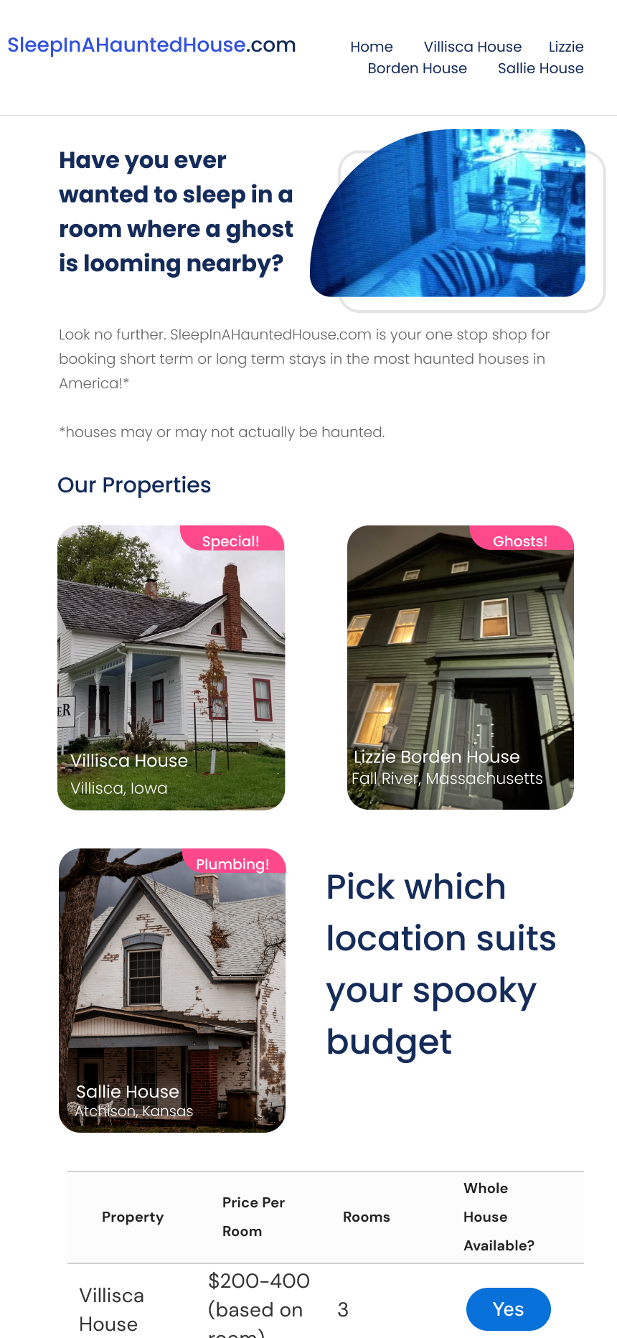
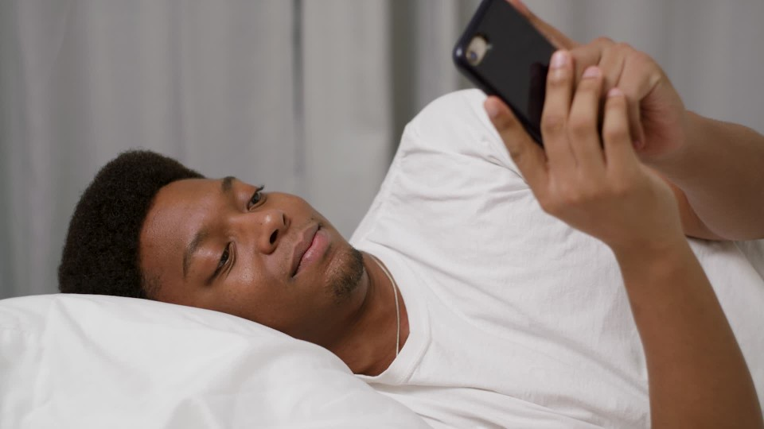
Mobile Functionality
Allows users to access the website on all types of devices

Slide 11
Thank you
Gladys Angle
480-326-6700
che2040698@maricopa.edu
www.SleepInAHauntedHouse.com

